Slide 1
Big Al's record store
record inventory system
David Clarkson

Slide 2
Project timetable
Day 1 – Thursday – decision & start on planning
Day 2 – Friday – planning
Day 3 – Saturday– coding
Day 4 – Sunday - coding
Day 5 – Monday - coding/bug-fixing
Day 6 – Tuesday – HTML/CSS
Day 7 – Wednesday – HTML/CSS bug-fixing & presentation
Project Submission WEDNESDAY midday
Day 8 – presentation

Slide 3
Planning
Trello board
Case diagram
Class diagram
Object diagram
Activity diagram

Slide 4
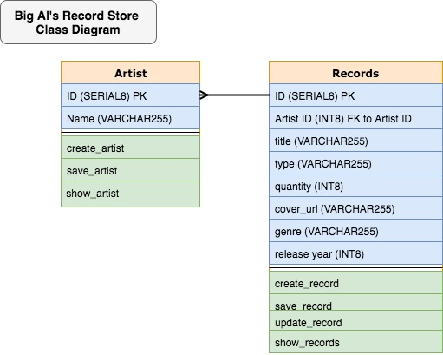
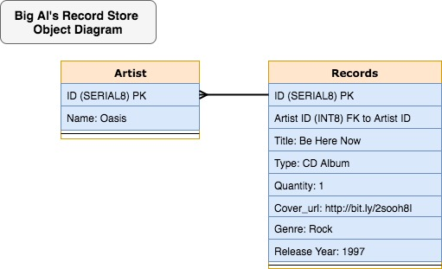
CLASS & OBJECT DIAGRAMS

Slide 5
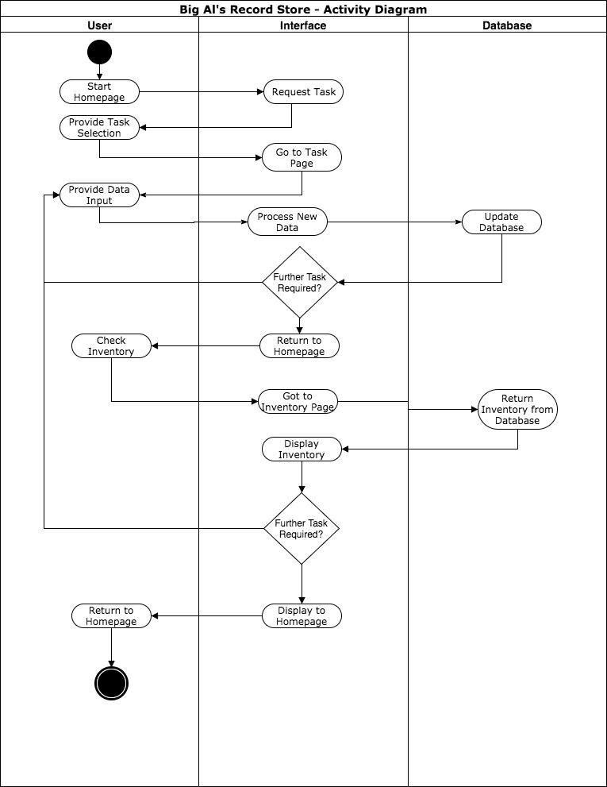
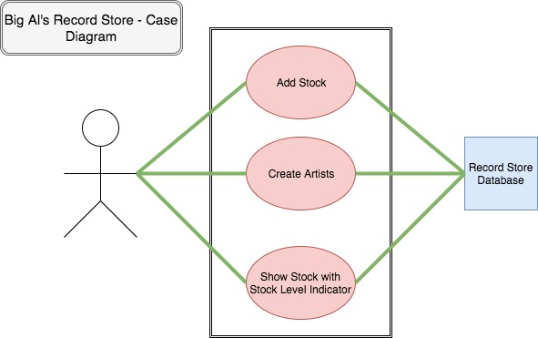
CASE & Activity DIAGRAMS

Slide 6
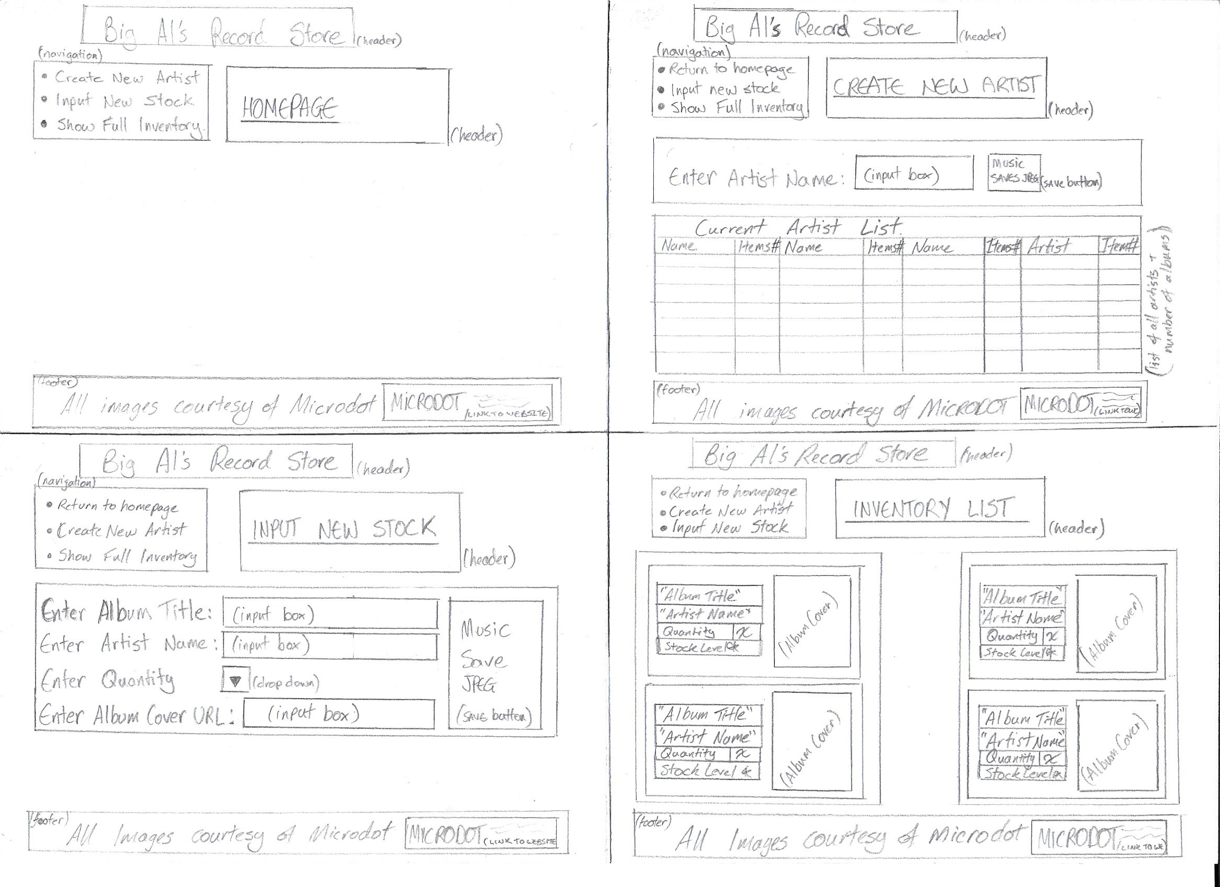
WIREFRAME DIAGRAM

Slide 7
Implementation constraints plan
Constraint | Possible Effect of Constraint on Product | Solution
Hardware & Software Platforms | Possible use of different devices to view webpage | Discover likely devices in advance and code accordingly I.e. flexbox layout.
Performance Requirements | Only one user, so few requests to database in one session. | If an increase in users occurs bandwidth & database requests will need to be considered.
Persistent Storage | Only one user – with a limited amount of data for the moment. | Local Hosting will suffice for the moment, but if the database increased another hosting solution may need to be found I.e. AmazonS3.
Usability | Images may become stretched when page is resized. | Ensure flexbox approach is taken where possible.
Budgets | If off-site storage is required then this may increase cost for database overall. | Use local hosting + on-site back up to keep costs to minimum.
Time Limitations | MVP to be completed and submitted by midday 14/06/17. | Good time management, leaving enough time for planning & coding.

Slide 8
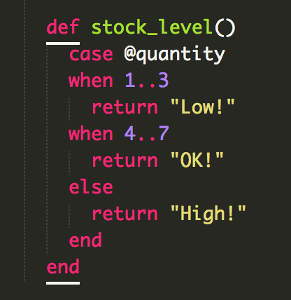
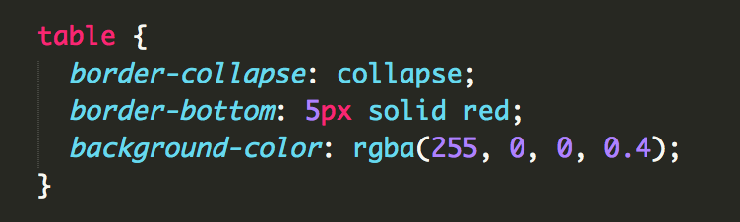
Coding/HTML/CSS
Stock Indicator
Table Transparency

Slide 9
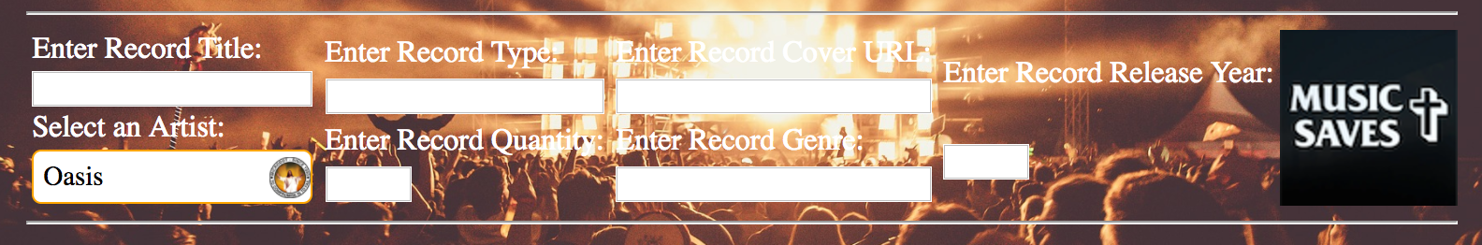
Coding/HTML/CSS
Flexboxing Several in One...

Slide 10
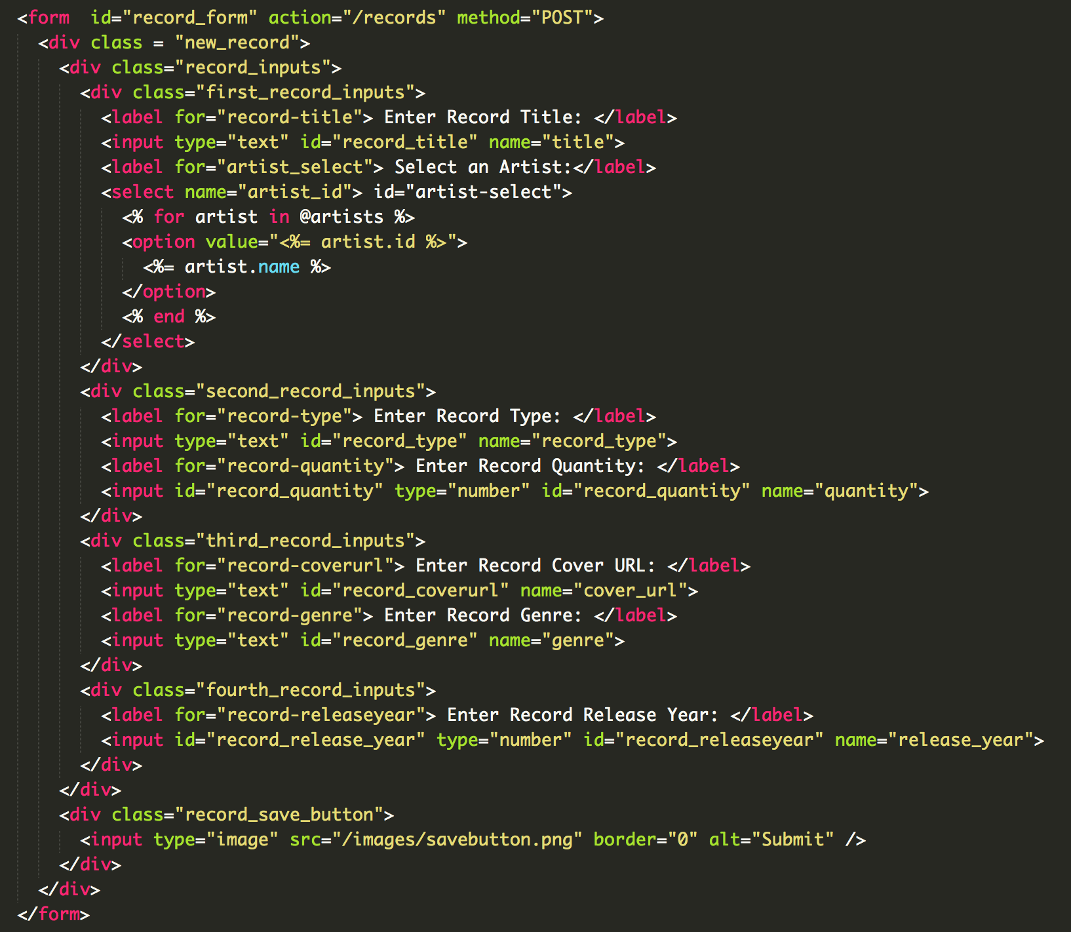
Coding/HTML/CSS
Flexboxing Several in One

Slide 11

Let's have a look at the trello board

Slide 12
DEMO TIME!!!
Big Al’s Record Store Inventory System

